Slide 1
Introduction to Arduino
Cyber stars - 2014

Slide 2
What is the Arduino?
Programmable micro-controller
Let’s us write programs/code that interact with the physical world!
What do people use Arduino for?
http://playground.arduino.cc/projects/ideas
Whatever you can dream up!

Slide 3
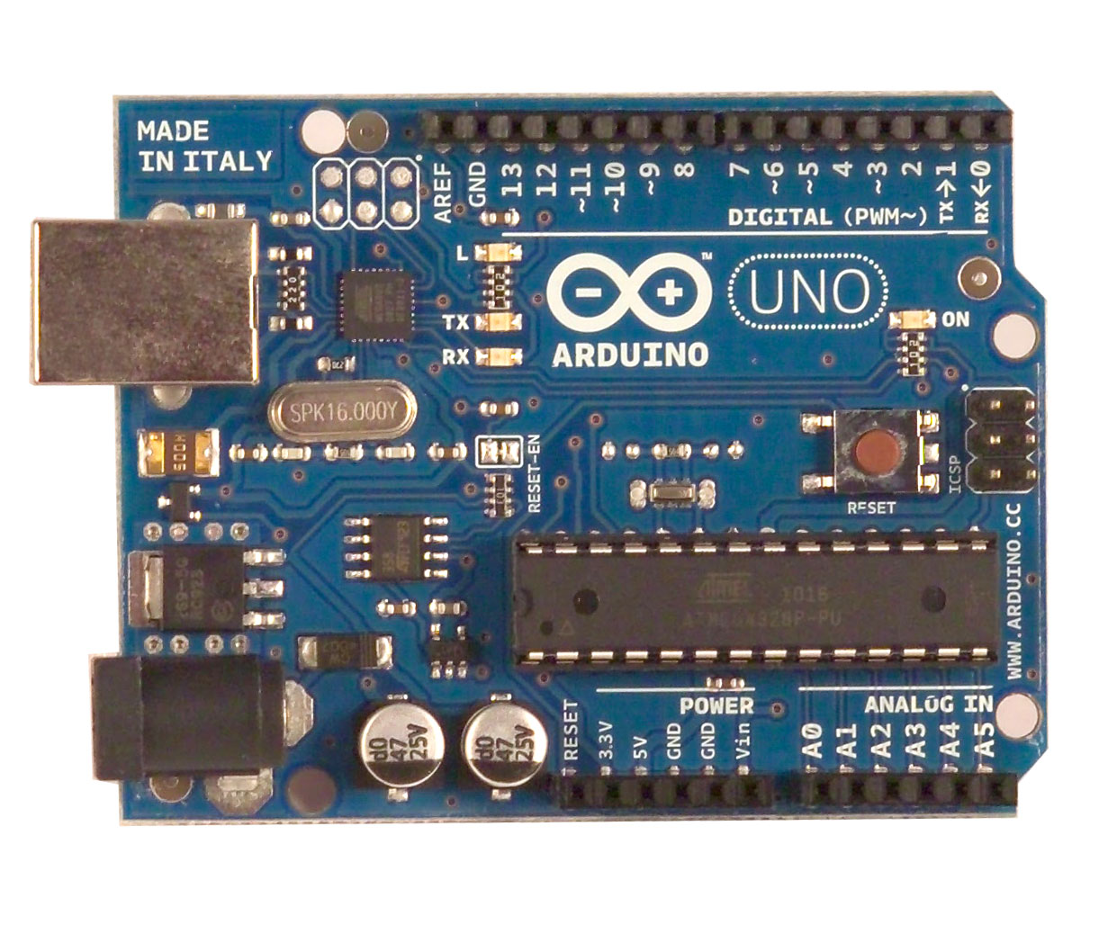
Arduino Basics

Slide 4
Arduino Basics - Layout
14 Digital IO pins (pins 0 – 13)
6 Analogue In pins (pins 0 – 5)
6 Analogue out pins (pins 3, 5, 6, 9, 10, 11)
Powered by USB or AC adapter

Slide 5
Bare minimum code
void setup() { // put your setup code here, to run once:
}
void loop() { // put your main code here, to run repeatedly:
}

Slide 6
Bare minimum code
setup : It is called only when the Arduino is powered on or reset. It is used to initialize variables and pin modes
loop : The loop functions runs continuously till the device is powered off. The main logic of the code goes here. Similar to while (1) for micro-controller programming.

Slide 7
PinMode
A pin on arduino can be set as input or output by using pinMode function.
pinMode(13, OUTPUT); // sets pin 13 as output pin
pinMode(13, INPUT); // sets pin 13 as input pin

Slide 8
Reading/writing digital values
digitalWrite(int pint, HIGH/LOW)
HIGH = ON, LOW = OFF
This turns on/off any pin that has been configured as an OUTPUT
Arduino is 5V, turning a pin to HIGH turns output pin to 5V and vice versa
digitalWrite(13, LOW); // Makes the output voltage on pin 13 , 0V
digitalWrite(13, HIGH); // Makes the output voltage on pin 13 , 5V
int buttonState = digitalRead(2); // reads the value of pin 2 in buttonState

Slide 9
Analog to Digital Conversion
What is analog ?
It is continuous range of voltage values (not just 0 or 5V)
Reading analog: 0 – 1023
Writing analog: 0 - 254
Why convert to digital ?
Because our microcontroller only understands digital.

Slide 10
More functions
Delay(int) – amount of time a program should wait in milliseconds
Delay(1000) = delay for 1 second

Slide 11
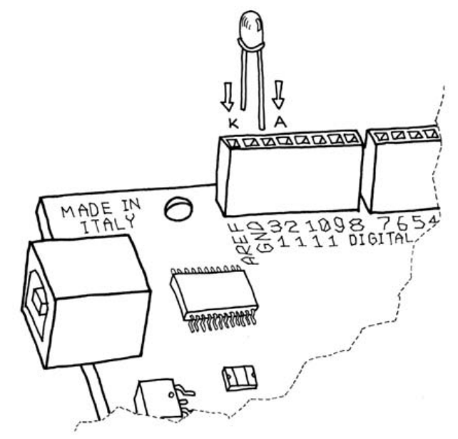
Let’s start with a blinking LED
K indicates cathode – Negative
A indicates anode – Positive
Do NOT let this run for extended periods
of time!

Slide 12
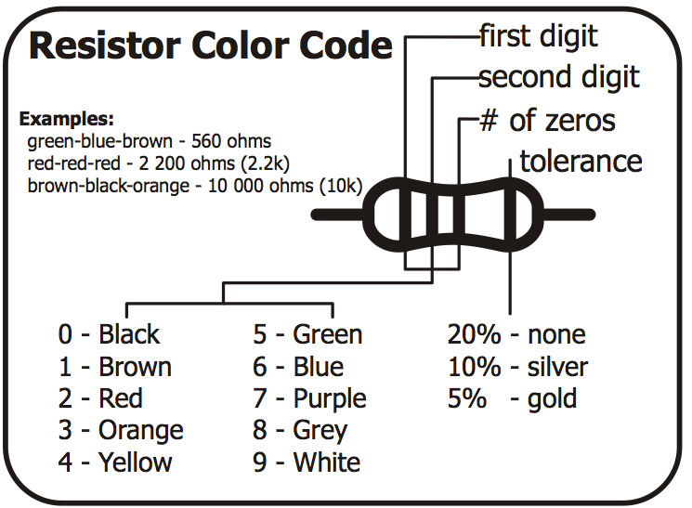
Our next sketch – another LED

Slide 13
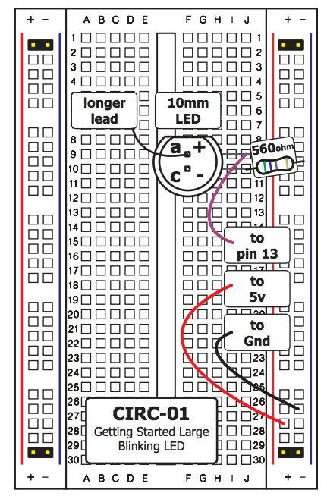
CIRC01

Slide 14
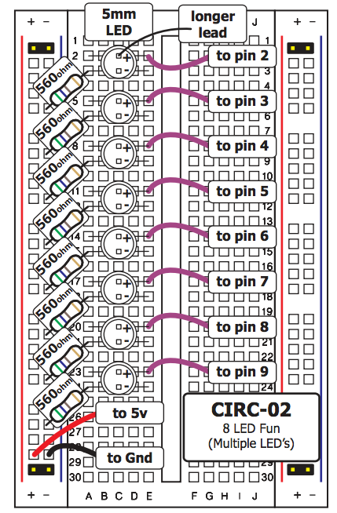
8 LED Fun – CIRC 02

